Slide 1


18 NOVEMBER 2025
{ solx }
An LLVM-based Solidity Toolchain

Slide 2
Phase 1 - Multi-target Support
Goal • Problem • Solution • Result
Scope | Solidity compiler for ZKsync VM
Timeframe | ~12 months
Headcount | 1 Front-End Engineer 1 LLVM Engineer 1 Engineer in Test
Baseline | ZKsync VM 25% Ready
2021
Jan
2022
2023
2024
2025
2026

Slide 3
Phase 1 - Multi-target Support
Goal • Problem • Solution • Result
Solidity
Only one compiler available: solc
Limited multi-target support
EVM-centric pipelines and IRs
Yul
EVM
Assembly
High-level
Low-level
EVM
Bytecode
2021
Jan
2022
2023
2024
2025
2026

Slide 4
Phase 1 - Multi-target Support
Goal • Problem • Solution • Result
Don’t Implement. Reuse!
Solidity
Yul
LLVM IR
MIR
solc
zksolc
LLVM
ME
LLVM
BE
Reused / adapted: >95%
Implemented: <5%
2021
Jan
2022
2023
2024
2025
2026

Slide 5
Phase 1 - Multi-target Support
Goal • Problem • Solution • Result
Great | Not so great
🎉 Solidity v0.8 on ZKsync VM | 😿 Solidity v0.8 only
✅ solc/Yul ported to LLVM* | ⚠️ Semantic differences with L1
 | 💀 Compiler crashes
 | ⏳ Long compilation time
*Yul to RISC-V for PolkaVM
https://github.com/paritytech/revive
2021
2022
Jan
2023
2024
2025
May
2026

Slide 6
Phase 2 - EVM Assembly Support
Goal • Problem • Solution • Result
Scope | Solidity <0.8 via EVM Assembly
Timeframe | ~6 months
Headcount | 1 Front-End Engineer 1 LLVM Engineer 1 Engineer in Test
Baseline | Full Yul pipeline in place
2021
2022
Jan
2023
2024
2025
2026

Slide 7
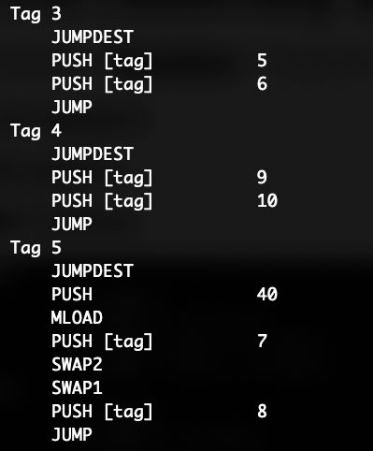
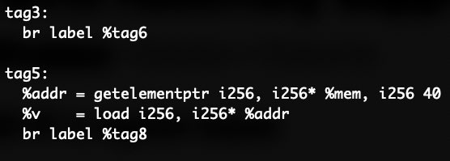
Phase 2 - EVM Assembly Support
Goal • Problem • Solution • Result
EVM Assembly is stack-based - LLVM IR is register-based
Obfuscated control flow & call graph
2021
2022
Jan
2023
2024
2025
2026

Slide 8
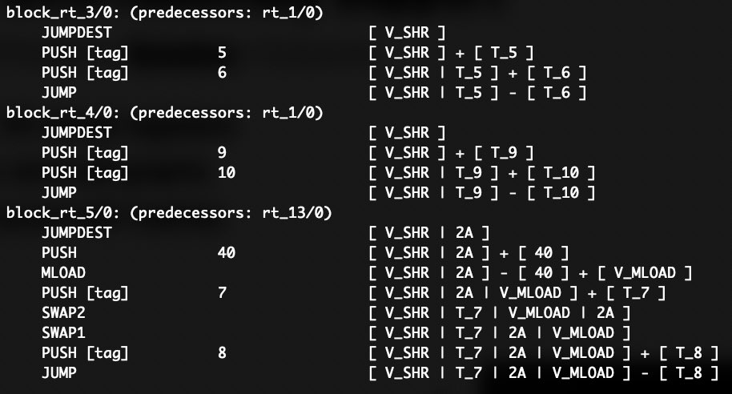
Phase 2 - EVM Assembly Support
Goal • Problem • Solution • Result
Registerization: mapping onto LLVM IR virtual registers
Stack analysis to restore control flow and call graphs
2021
2022
Jan
2023
2024
2025
2026

Slide 9
Phase 2 - EVM Assembly Support
Goal • Problem • Solution • Result
Great | Not so great
🎉 Solidity ≥0.4.12 on ZKsync VM | 🛠️ Extra optimizations needed
 | 🧳 solc fork required (~80 branches)
 | ☣️ Complex and fragile translation
2021
2022
Jul
2023
2024
2025
2026

Slide 10
Phase 3 - EVM
Goal • Problem • Solution • Result
Scope | EVM Back End in LLVM | MLIR Codegen
Timeframe | ~18 months | ? months
Headcount | 1 LLVM Engineer | 1 Front-End Engineer
Baseline | LLVM-based compiler for ZKsync VM | Solidity AST
2021
2022
2023
May
2024
2025
2026

Slide 11
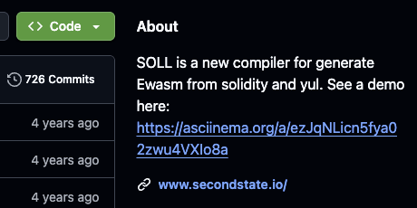
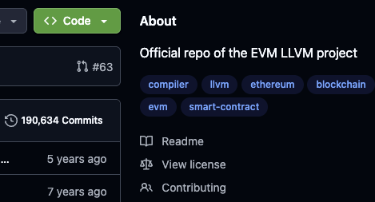
Phase 3 - EVM
Goal • Problem • Solution • Result
SOLL
EVM LLVM
No EVM?
2020
2021
2021
2022
2023
May
2024
2025
2026

Slide 12
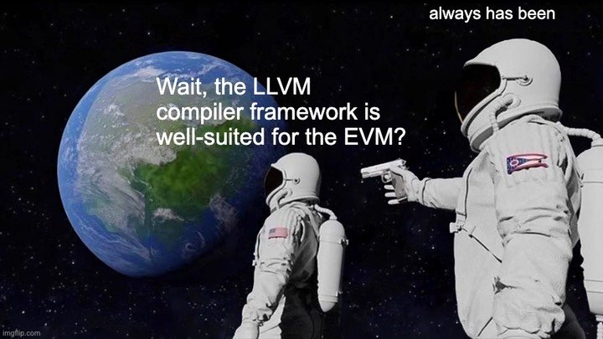
Phase 3 - EVM
Goal • Problem • Solution • Result
2021
2022
2023
May
2024
2025
2026

Slide 13
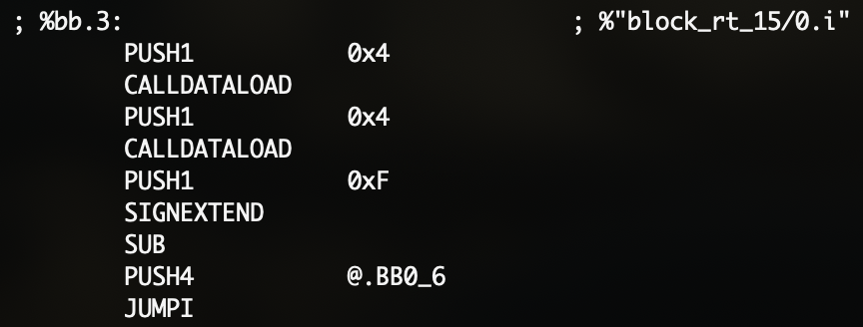
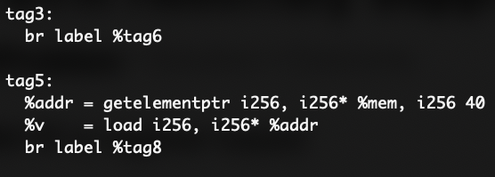
Phase 3 - EVM
Goal • Problem • Solution • Result
stackification
Inspired by:
WASM LLVM BE
Solc EVM BE
2021
2022
2023
May
2024
2025
2026

Slide 14

Phase 3 - EVM
Goal • Problem • Solution • Result
Great | Not so great
✅ EVM Target in LLVM | ❌ Can’t use it yet
S O L X
2021
2022
2023
2024
Nov
2025
2026

Slide 15
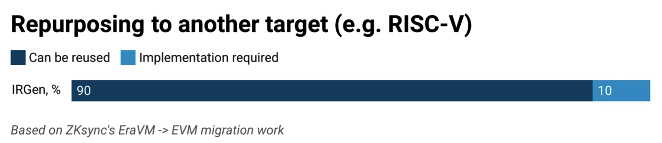
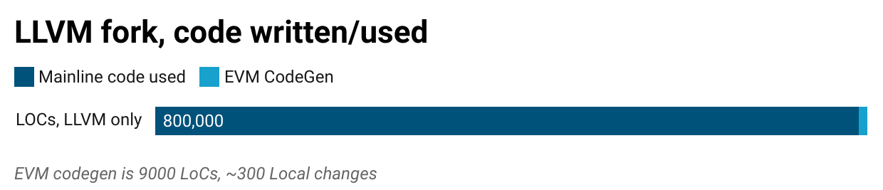
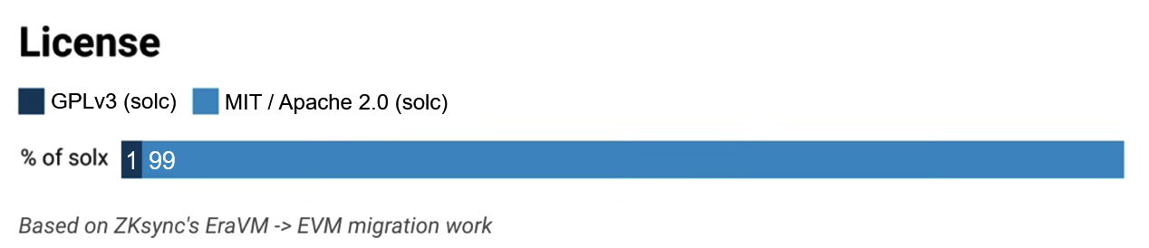
Phase 3 - EVM
Goal • Problem • Solution • Result
2021
2022
2023
2024
Nov
2025
2026

Slide 16
solx v0.1.0: stack-not-so-deep
Goal • Problem • Solution • Result
Scope | solx: LLVM-based compiler for the EVM
Timeframe | ~6 months
Headcount | 1 Front-End Engineer 3 LLVM Engineers 1 Engineer in Test
Baseline | EVM Back End in LLVM
2021
2022
2023
2024
Nov
2025
2026

Slide 17
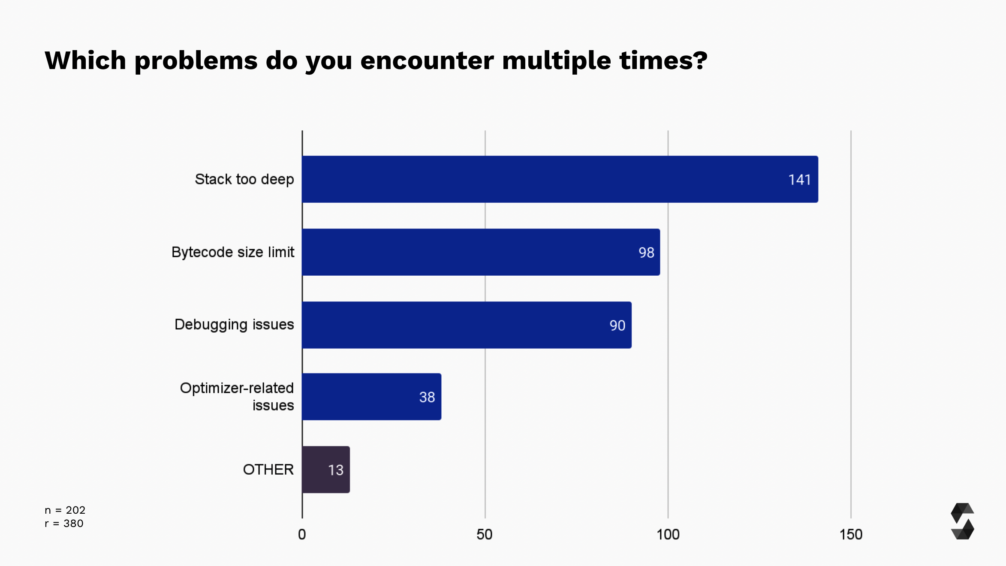

solx v0.1.0: stack-not-so-deep
Goal • Problem • Solution • Result
Survey
Survey
Survey
Survey
2021
Jan
2022
Feb
2023
Mar
2024
Apr
Nov
2025
2026

Slide 18
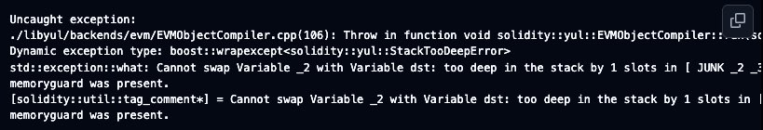
solx v0.1.0: stack-not-so-deep
Goal • Problem • Solution • Result
solx | solc / Yul
Tries the stackification once Records variables that don’t fit into the stack Allocates an extra heap area for spills Recompiles the translation unit | Predicts the stack pressure Offloads data from the stack Does not re-run the compilation
2021
2022
2023
2024
Nov
2025
2026

Slide 19
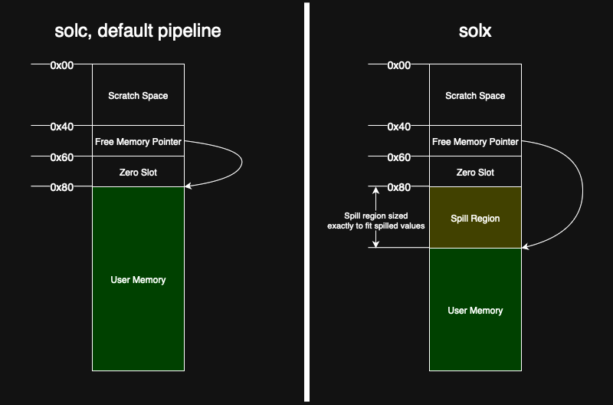
solx v0.1.0: stack-not-so-deep
Goal • Problem • Solution • Result
2021
2022
2023
2024
Nov
2025
2026

Slide 20
solx v0.1.0: stack-not-so-deep
Goal • Problem • Solution • Result
Great | Not so great
✅ solx v0.1.0: stack-too-deep solved | ⏳ Long compilation times
🚀 Any codegen, no semantic changes | ⚠️ Bytecode size issues
🙀 First LLVM-based EVM compiler
☺️ Moderate gas usage reduction
2021
2022
2023
2024
2025
Jul
2026

Slide 21
solx v0.1.1: Compilation Time
Goal • Problem • Solution • Result
Scope | Don’t be slower than solc
Timeframe | ~1 month
Headcount | 1 FE Engineer
Baseline | solx is up to 3x slower than solc
2021
2022
2023
2024
2025
Jul
2026

Slide 22

solx v0.1.1: Compilation Time
Goal • Problem • Solution • Result
1. solc is single-threaded
2. Both solc and LLVM optimizers enabled
2021
2022
2023
2024
2025
Jul
2026

Slide 23
solx v0.1.1: Compilation Time
Goal • Problem • Solution • Result
❌ Add multi-threading to solc
✅ Turn off the solc optimizer
2021
2022
2023
2024
2025
Jul
2026

Slide 24
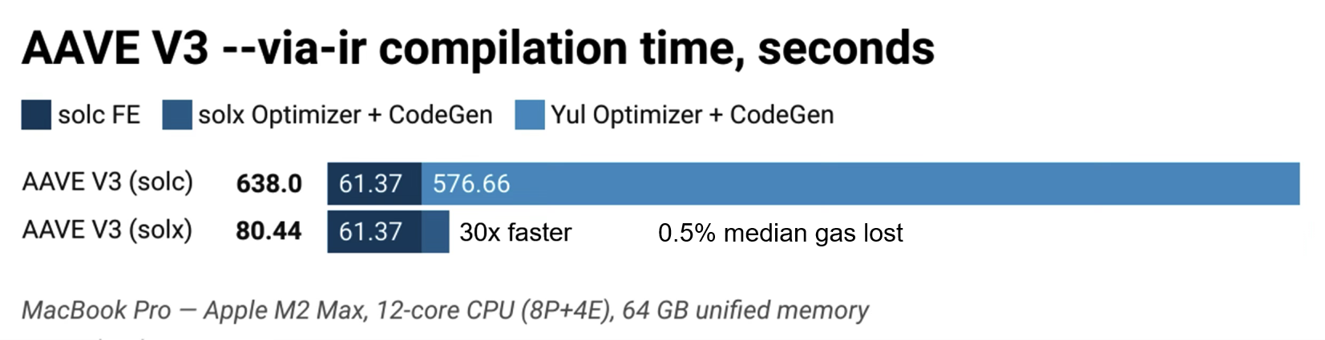
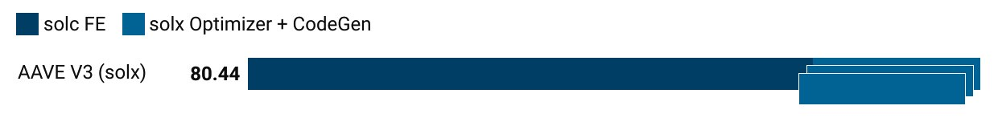
solx v0.1.1: Compilation Time
Goal • Problem • Solution • Result
2021
2022
2023
2024
2025
Jul
2026

Slide 25
solx v0.1.2: Bytecode Size
Goal • Problem • Solution • Result
Scope | Fit into the EVM bytecode size limit
Timeframe | ~1 month
Headcount | 1 LLVM Engineer
Baseline | Bytecode is 6% larger (median)
2021
2022
2023
2024
2025
Jul
2026

Slide 26
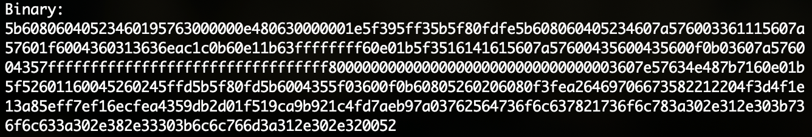
solx v0.1.2: Bytecode Size
Goal • Problem • Solution • Result
LLVM passes not tuned for EVM
Strong preference for gas reduction
2021
2022
2023
2024
2025
Jul
2026

Slide 27
solx v0.1.2: Bytecode Size
Goal • Problem • Solution • Result
PUSH32 0xffffffffffffffffffffffffffffffffffffffffffffffffffffffffffffffff
PUSH1 0x01
PUSH0
SUB
Constant unfolding
⚠️
EVM Limit
Exceeded
🛠️
Unfold More
✅
EVM Limit
Respected
Adaptive gas/size tradeoff
2021
2022
2023
2024
2025
Jul
2026

Slide 28
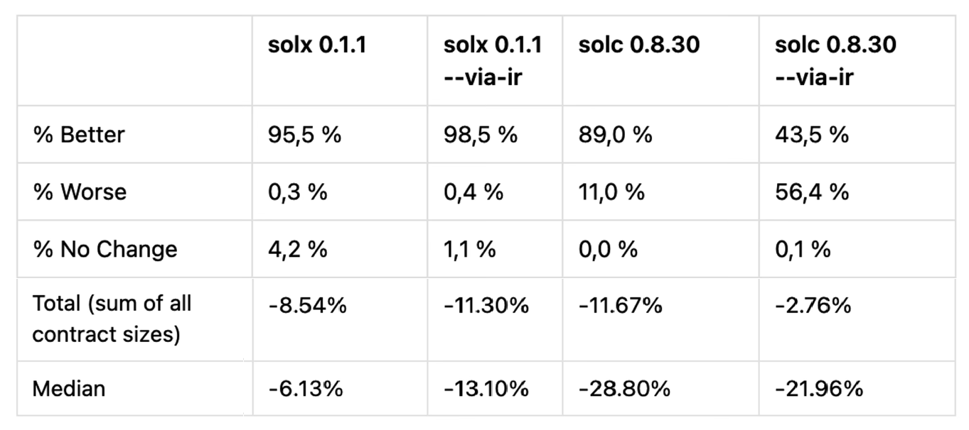
solx v0.1.2
Goal • Problem • Solution • Result
Bytecode size
2021
2022
2023
2024
2025
Sep
2026

Slide 29
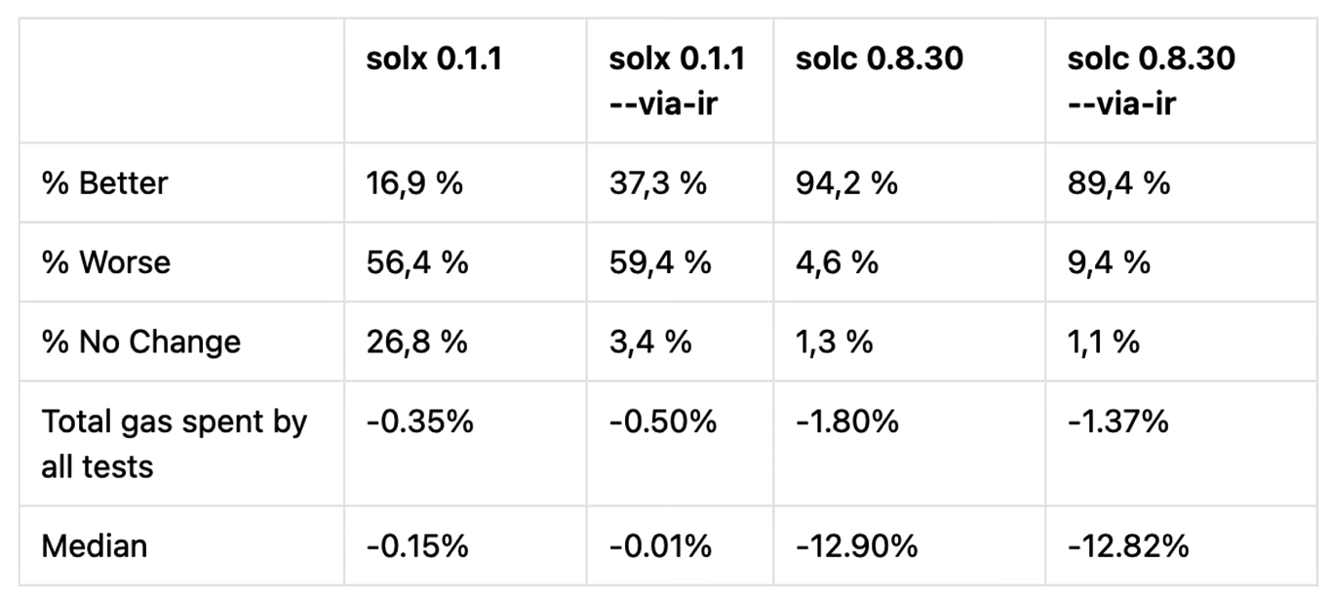
solx v0.1.2
Goal • Problem • Solution • Result
Gas
2021
2022
2023
2024
2025
Sep
2026

Slide 30


Coming soon: MLIR Codegen
Debuggers & Tools
3-6x compilation time
2021
2022
2023
May
2024
2025
2026

Slide 31
Testing & Security
✅ Integrated | 🛠️ WIP || Coming soon
24 Foundry projects 4 Hardhat projects Upstream Solidity tests ZKsync VM tests LLVM unit tests | Fuzzing / bug mining >90% Code Coverage Contract Sanctuary Front-end & back-end audit
2021
2022
2023
2024
2025
Nov
2026

Slide 32
Wen solx?
✅ Recommended | 🛠️ Production
Fast development (compilation time) Stack-too-deep annihilation | Non-mission-critical projects Projects with ~100% test coverage
🙏 Share your experience
2021
2022
2023
2024
2025
Nov
2026

Slide 33

Website: https://solx.zksync.io/
GitHub: NomicFoundation/solx
Blog: https://zksync.mirror.xyz/
Telegram: @solx_devs
X: solx_compiler
TRY
{ solx }
NOW
Q&A

